Slide 1
Aeronet SME - asset recovery - david adams

Slide 2
Introduction
Definition
The recovery and return (or disposal) of equipment owned or recently purchased by a company. The service usually involves packaging, inventory and transportation. Asset recovery services are often used to redeploy assets or collect end-of-lease equipment. Projects may need one or all of the following services – standard packaging, custom crates, chain of custody requirements, on-site or off-site packaging, temporary storage, barcode scanning, recycling, or even hard drive wiping.
Industries that use Asset Recovery services
Computer/Network Hardware companies
Equipment leasing companies
Retail Stores
Financial Institutions
Liquidators
Data Centers

Slide 3
Examples
Situations that might call for Asset Recovery services
Pickup, package and …
Return hardware equipment from data centers
Return leased computer equipment (e.g. school districts)
Return Point of Sale (PoS) systems from retail stores
Return Computer equipment from bank branches
Move medical equipment to another location
Move retail store fixtures to another location

Slide 4
Transportation Packaging Requirements
An example of one company’s requirements:-
Each piece of equipment will be bubble-wrapped (using 1” bubble) with a minimum of three layers of bubble wrap
Wrapped equipment will then be placed in double walled (275 pound burst strength) boxes with the appropriate amount of packaging material (bubble-wrap, paper) to keep the equipment from moving in the box while in transit. (Please refrain from using Styrofoam peanuts of pieces).
Double tape the boxes when closing them up
Boxes will then be placed on a wood pallet?
Boxes should have at least 2 bands securing majority of boxes to the pallets
The pallet should be completely shrink-wrapped a minimum of 4 times around the exterior of the pallet ensuring no cardboard is left unwrapped

Slide 5
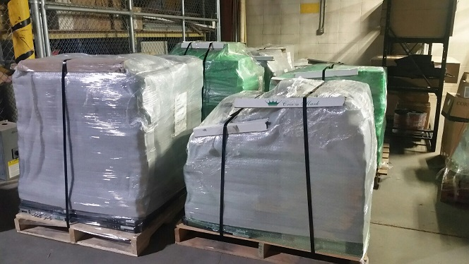
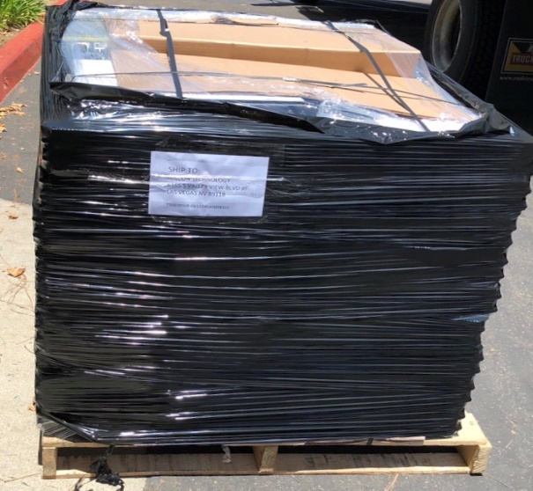
Packing Service Level 1
Level 1 Packing – Stack and Band
Asset(s) to be stacked , corner board protection added, stretch wrapped and banded to a pallet

Slide 6
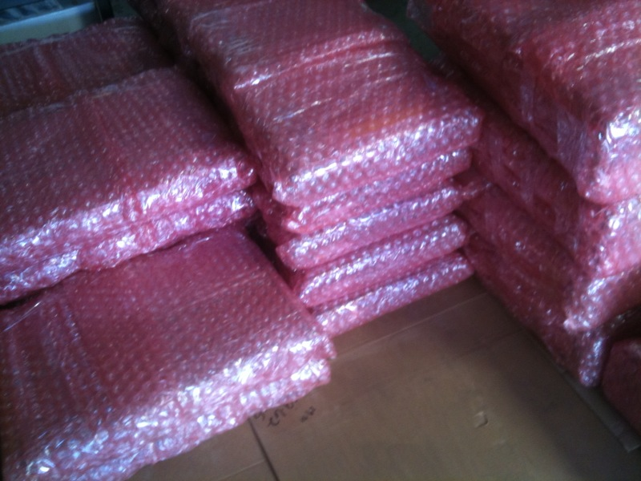
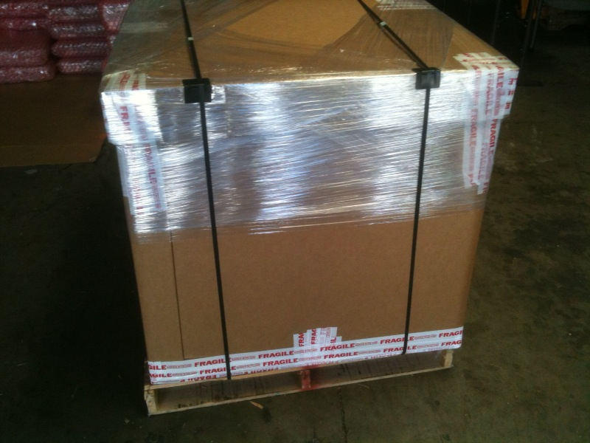
Packing Service Level 2
Level 2 Packing – Anti-Static Bubble Wrap
Asset(s) to be individually wrapped in anti-static bubble, placed inside a double wall corrugated container and banded to a pallet

Slide 7
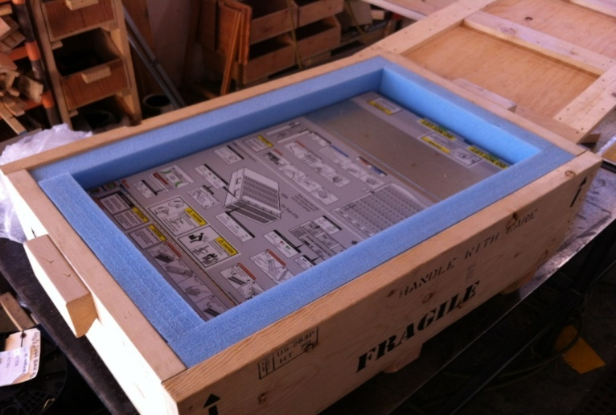
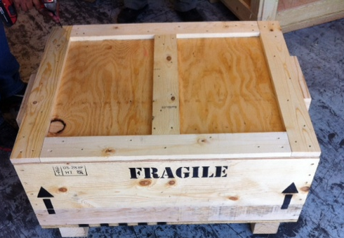
Packing Service Level 3
Level 3 Packing – Custom Wood Crating
Asset(s) to be individually bubble wrapped with anti-static and placed in a custom-made wood crate

Slide 8
Packaging Provider
Prime Delivery Systems, Inc.
Contact: Armando Monson
Email: armondom@primedeliverylax.com
Cell: 310-562-2090
Website: primedeliverysystems.com

Slide 9



THANK YOU
Contact David Adams
Office: (310) 787-6960 | Mobile: (805) 407-5700 | DAdams@Aeronet.com
Connect with Us:

