Slide 1


We Make It Happen
One Shipment at a Time®
Aerotrac Online (AOL)
- SME Presentation

Slide 2
Today’s Objectives
Understanding AOL’s capabilities
Navigating through the client AOL set-up
Benefits to a client and Aeronet

Slide 3
Aerotrac Online
Aerotrac Online (AOL) allows our clients to place orders, as well as create and track all of their shipments, from their computer.
Aerotrac’s ease-of-use functionality optimizes the entire process, and keeps our clients up-to-date by placing all of the important information directly at their fingertips.
Online Tracking and Full Visibility
Ready-to-Print Documentation
Critical Status Updates and Milestones
Customizable Dashboard
Auto-Distributed Customized Reporting
Ability to quote and book LTL shipment with visibility to the carrier and transit time

Slide 4
AOL Statistics
Client | # of AOL shipments
Arista | 2,166
Genuine Scooter | 1,255
Cokeva | 407
ePlus | 401
Viasat | 383
Intrapump | 268
Joseph Electronics | 223

Slide 5
Lisley Davenport – AOL Overview

Slide 6
Greg Spudic - client

Slide 7
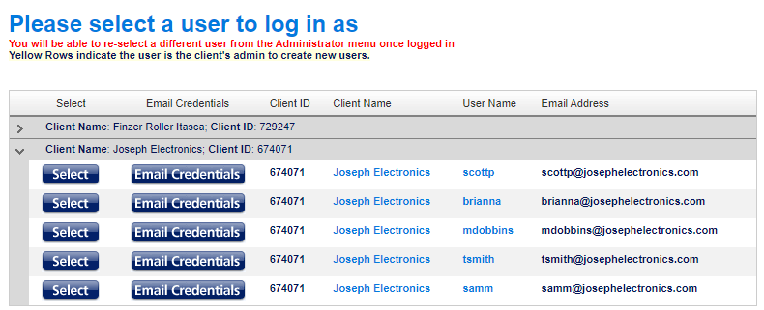
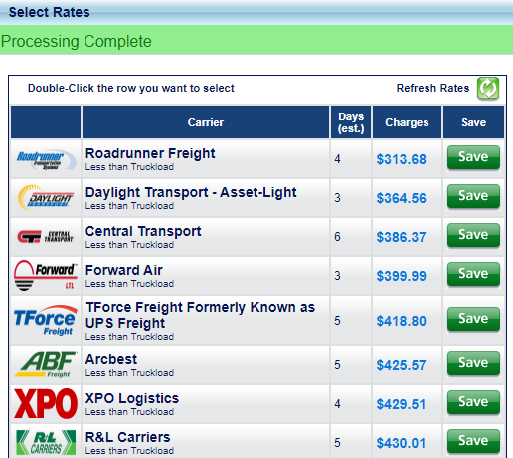
Aerotrac Online – Customer Advantages
Joseph Electronics
Time, Cost and Labor of Dedicated Staff
Multiple User interface (Person or Department Level)
One system of entry – No phone calls, Cost and Pick Up set
Carrier Options – Quality, Service Level and Choice in their hands. (Customer selects creates own Value Proposition)
Ease for Quotes, BOL’s, Labels, P/U Confirmation
Track & Trace simplified via a single portal
Reporting – Activity, Financial, Statements
Accounts Payable – ONE Statement, HUGE Benefit. ZERO chasing of BOLs, Invoices, PODs. Leverage CFO, Accounting Dept.
Transportation costs controlled and lowered

Slide 8
Aerotrac Online – Operational Advantages
Aeronet Station
Cost, Time and Labor (Phone time, Quote prep, Win – Lose)
Estimated LTL Saving = 15-30mins X Emp. Cost X Internal/External
Staff Utilization flexibility
Secondary Cost, Time and Labor for Track & Trace or POD
Online Availability for Orders-in-Transit, POD Orders, Pending Orders, and Recent Orders.
Sales owner accessibility
Operational - Sales cooperation
Guaranteed Margin stability

