Slide 1


We Make It Happen
One Shipment at a Time®
Aeronet 2022 Mid-Year Review
“One Team Working Together”

Slide 2
MID-YEAR REVIEW AGENDA
Hal Year Financial Update
Half Year Business Analysis
The Path Forward
David Gibson – EVP International
Jim Wallace – GM Trans-Border Mexico
Overcoming Challenges – 3 Frontline Perspectives
Conclusion

Slide 3
Half year financial update

Slide 4
Revenue - Achieved Vs. Budget
For H1 we achieved a total Revenue of $136,577,141 against a budget of $122,877,026

Slide 5
Margin - Achieved Vs. Budget
For H1 we achieved a Margin of $30,033,007 against a budget of $28,821,965
Need to continue pushing the Margin % higher
- Work with Ops to ensure we are controlling our costs

Slide 6
Half year business analysis

Slide 7
Top 5 Sales Associates by Margin
1 - $3,363,634
2 - $3,288,557
3 - $1,876,143
4 - $1,694,136
5 - $1,570,680
Incredible numbers across a diverse set of industry verticals and services sold

Slide 8
H1 2021 vs H1 2022 – Top Clients
Our top 35 clients accounted for $6,761,355 in margin for H1 2021
For H1 2022 that number increased significantly to $15,073,447
The top 35 are key, but equally important that we retain a diversified portfolio of clients based on:-
Company size
Industry vertical

Slide 9
CLIENT INDUSTRY ANALYSIS – H1 2022
‘Blank’ - Too many clients don’t have the Industry Code included in the Aerotrac profile, we need to clean this up

Slide 10
H1 2021 vs H1 2022 – Service Level

Slide 11
New Business Analysis
The amount of new opportunities in our sales pipeline is a leading indicator of confidence in the market
As we head towards 2023, it is more important than ever that we have a full pipeline with a balanced portfolio of opportunities
Through June, we have created 587 new accounts in Aerotrac which have generated $1,259,163 margin
However, of those 587, 318 (54%) have zero margin
I understand that some opportunities have a longer sales cycle, but why do over half of new accounts created have no revenue and a significant number don’t even have credit established?
The 2nd page of your monthly sales report where it lists your new accounts created in 2022, now has them broken down by those with credit established and those that don’t. Needs further analysis

Slide 12
The path forward

Slide 13
The Plan for Future Growth
As we continue to establish strong revenue growth, the next goal is to significantly grow our profit margins.
This can be done through a strategic plan that includes infrastructure, increased automation, and which, will permit our Operations colleagues to work more efficiently

Slide 14
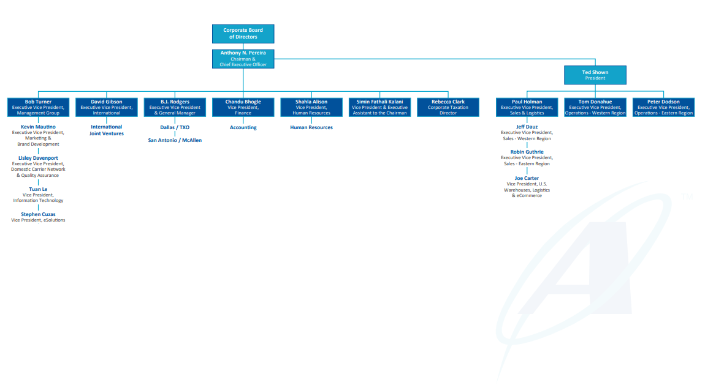
Organizational Chart

Slide 15
The Aeronet Secret of Success
Making it Happen the Aeronet Way
Our goal at Aeronet is to generate $250M in revenue, with at least $6.25M in profit, by the end of December 2022
This is not an easy goal, and it will take diligent work by every Aeronet associate in order to achieve it
But when we do achieve this goal, we know that was a firm belief in our core values of Integrity, Commitment and Passion that helped us get there
Key to this, is not only the belief in our core values, but the belief in ourselves
If we have a strong faith in what we are capable of, both as individuals and as a team, then we will achieve our goals.

Slide 16
David Gibson – EVP, International

Slide 17
International Team
Cynthia Town – FCL exports
Caroline Oliveira – Agent amendments, Inbound / Outbound air & ocean quotes
Blanca Munoz – Agents quotes, RFQ assistance with international parts
Adam Gibson – Agent quotes, DAP tariff procurement
David Gibson – International agent relations & escalation point
Group email: MAXIntl@Aeronet.com

Slide 18
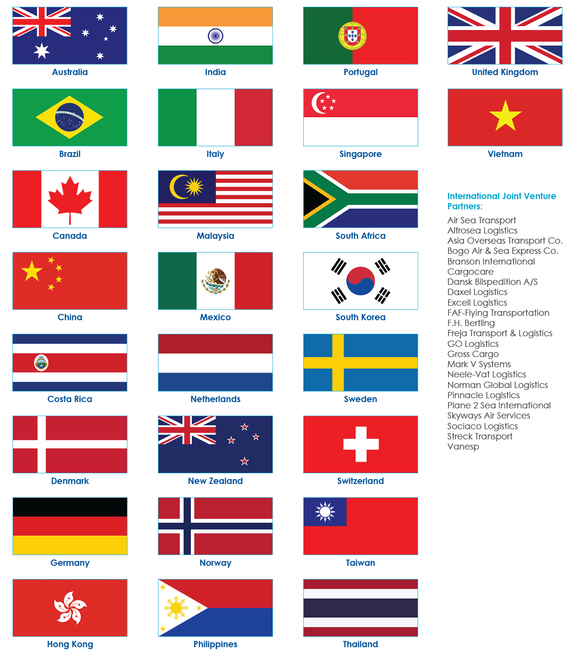
Overseas Joint Ventures
Aeronet has strategic international joint ventures with logistics partners in Europe, Asia, North America, Oceania, South America and Africa

Slide 19
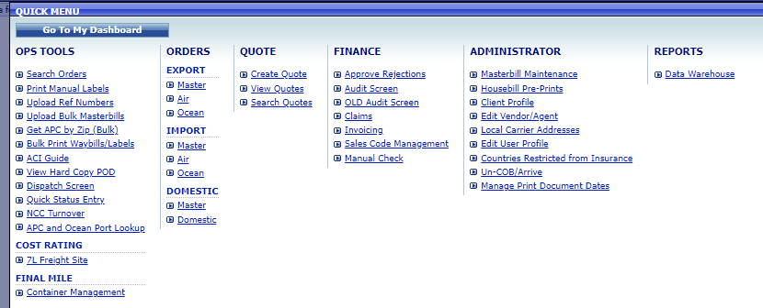
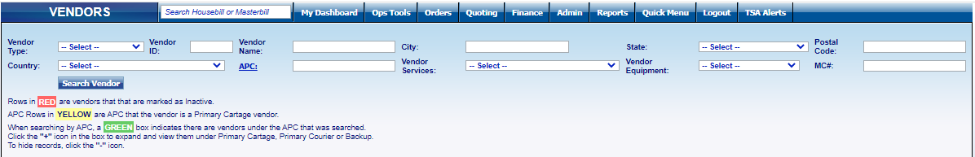
Finding an Agent in Aerotrac

Slide 20
Jim wallace – GM, San Antonio, Trans-border mexico

Slide 21
Comprehensive Services / Solutions
Time-definite LTL consolidation
Expedited services (charters, hand-carries, air, hot-shots)
International air and ocean
U.S. – Mexico milk-runs and FTL
Warehouse and distribution
U.S. and Mexico Customs clearance

Slide 22
Strategic Relationship – Xcell Logistics
Aeronet has signed a JV agreement to partner with Xcell Logistics
Currently interviewing for a shared sales resource
Mexico Facilities
Mexico City Laredo / Nuevo Laredo
Monterrey Guadalajara
Saltillo Manzanillo
Queretaro Veracruz

Slide 23
Achieving Success - Keys
Focus & probe on client needs & current deficiencies
Transit times & delays
Unreliable costs
Poor communication / updates
Focus on manufacturing opportunities and Supply Chain
Request shipment & business data
Engage SAT / Xcell in developing solutions

Slide 24
Overcoming Challenges – 3 Frontline prospectives

Slide 25
Greg Spudic

Slide 26
Joseph Electronics – Aeronet Tools & Capabilities
Timing Hire Date – 3/2/20 COVID Date – 3/11/20 (WHO)
Commodity Sporting Events / Cable, Wiring, Cameras, Racking
Introduction COVID, Sr. Director Sales, Pickleball @ 0600
Challenge Sr. Sales Director – No transportation authority
Intro to Logistics Manager – “Lifer” Why do I need you?
Heavily invested in 1 Service Provider (R&L)
LTL not on the table initially
Overcome Find potential soft spots thru other channels, other PIC’s
Request meeting w/ CFO
Aeronet SME platform - Aerotrac
Live WebEx – Steve Cuzas

Slide 27
Joseph Electronics – Aeronet Tools & Capabilities
Overcome Live onsite DEMO Aerotrac w/ Logisitcs Manager
Demonstrate cost saving initiative w/ CFO
Provide multi-carrier options and single payment source
Trial Shipments FEB, 2021
Aerotrac installed MAY, 2021
Result Aeronet is LTL Provider of choice
REV / Month $20,000
Margins @ 25% - 30% / Shipment
Other revenue streams open – WH, Small Package
Summary Find Group activities – Remain active

Slide 28
Lesa matthews

Slide 29
Target Account: Disney Cruise Lines
Background Account that I’ve done business with for about 15 years – have had various pieces of the business and have been included in a number of RFPs. Supporting a cruise operation requires flexibility and urgency.
Industry Cruise Line
Commodity Ship spares, furniture, costumes, food items +
Challenge Presenting a new company unknown to DCL
Designated freight forwarder assigned – not looking to make any changes
COVID severely impacted the cruise industry
Identify/Recognize opportunity to gain entrance

Slide 30
Target Account: Disney Cruise Lines
Overcome Presenting end-to-end solution/s utilizing a J.V. Partnership
Bringing two ops teams together
Creating visibility – 2 separate operating platforms
One group email address for European suppliers
Export declarations - POA
Result Aeronet awarded multiple opportunities across all modes
REV / Month appx $150,000
Margins @ 25%
Summary Invest/maintain relationship
Understand need and opportunity/ies
Be ready
Don’t give up

Slide 31
Michael crowley

Slide 32
Sales Challenges
COVID hangover
Positions have changed / Contacts are wearing more than one hat
Tougher security / COVID excuse for getting past the front desk
Tightening economy / Consumer spending is down
Higher fuel prices have made clients think twice about expedited or air freight

Slide 33
Overcoming these Obstacles
Be respectful of client’s opinions and concerns – Offer virtual meetings or outdoor locations or alternatives to traditional meeting room scenarios
Understanding of their time constraints. Identify opportunities where Aeronet or I can help professionally and personally
Get creative, go at different times of the day. Drop off items that will sit on their desk not in the breakroom
Get creative with solutions, understand their budgets. Stay in front of them. Become a valued resource

Slide 34
conclusion

Slide 35
Next Steps
Mid-year 1-on-1 reviews with your Manager
Review performance YTD & agree H2 actions
Utilize SalesIntel to generate new business leads
Use our internal resources to your advantage
Feedback ideas/process improvements to make us all more successful
What do you need from Aeronet to close business?
Have fun and be successful

Slide 36

In Conclusion – Finding Your Cheese
How are you going to meet your sales goals for 2022-2023?
What do you want to achieve this year, both personally & professionally?
What is your Cheese?
And how will you get there?
At this mid-year point, take time to consider your positon
Re-read book, it might jog some new thinking
If you don’t have a copy, let me know

Slide 37
THANK YOU

