Slide 1
Aeronet Cold Chain SME - Jeff Dauz

Slide 2
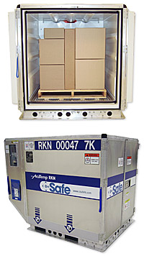
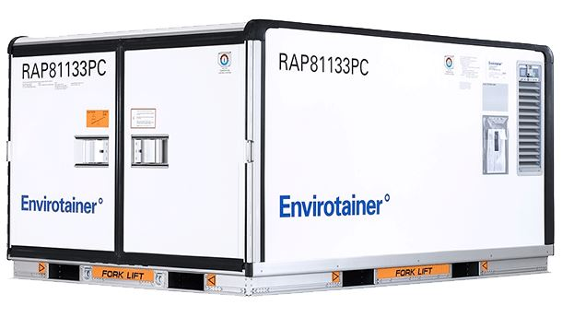
Packaging Solutions - Active
Active packaging are self contained units that can actively regulate temperature within the unit.
Csafe – RKN Airline Container with its own battery lasting 130 hours maintaining 4-25C as it recirculates cold air within the unit. Leasing options.
Envirotainer – RKN Airline Container that fit full pallets worth of cargo. They have units that fit 1-4 pallets.
Both companies offer detailed monitoring reports.

Slide 3
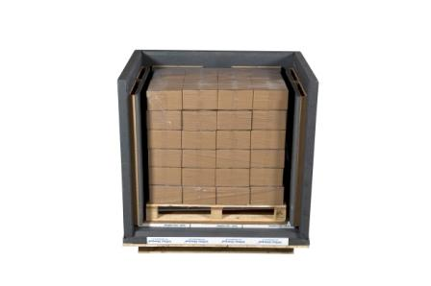
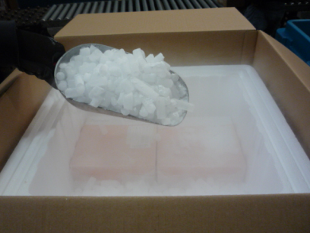
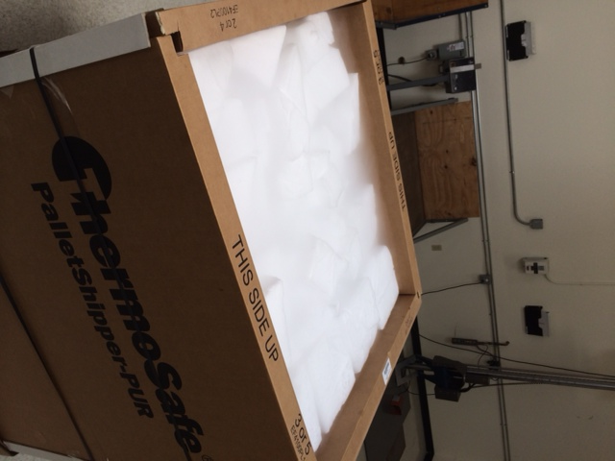
Packaging Solutions - Passive
Passive packaging on the other hand primarily uses dry-ice and gel packs to maintain the required temperature and trust
that the approved packaging will maintain the required temperature.
Cryoport Cryo Container (it uses dry vapor liquid nitrogen deep freeze -150C for 21 days) used for lab samples.
Phase Change Material (PCM) – precondition panels, which is new technology with the purpose to replace dry ice
Pallet Shippers (Blocks) ThermoSafe has several sections filled with blocks of dry ice bottom, middle, and top, in most cases.
Small pack coolers (Pellets) Softbox filled with dry ice pellets.
Passive Packaging for cold chain shipments go through a validation program known as ISTA (International Safe Transit Association) to confirm temperatures are maintained, so products do not perish in-transit. They rate the packing in hours, such as 48, 72, and 96 hours, which is when re-icing would be required. These are details that you need to discuss, so your operational teams and partners can react to delays, so shipments do not perish.
Softbox container, which is validated to maintain strict temperature ranges for up to 120 hours. ISTA-qualified.

Slide 4
Cold Chain – Temperature Ranges
Temperature ranges that are talked about in this vertical
0C or 32F dry ice blocks and pellets when product needs to remain frozen. They move as HAZMAT with airlines due to the dry ice under UN 1845
2C-8C or 36F-47F gel packs for when product needs to remain cold, but not frozen.
Ambient room temp

Slide 5
Cold Chain - Vendors
Airlines and Truckers
DHL ACS/CVG reefer trailers to hold pallets if needed (DHL Europe also offers
temperature storage at their hubs)
FedEx (Haulistic)
UA Newark reefer storage available
ART single temp and multi temp trailers
Dry Ice Vendors
Airgas Dry Ice
ACME Dry Ice
Temperature Logger Vendors
Deltatrac temp monitoring, location, and showing temperature excursions
Sensitech tracker captures location and temperature monitoring
Tive tracker captures location, temperature, shock, light, and humidity monitoring

Slide 6
Cold Chain – Clients & Services
Illumina - DNA sequencing company that manufactures medical devices and lab reagents.
Lab reagent dry ice pallet shippers and 2-8 via air and ground
Same-day Phase Change Materials from LAX to SAN weekly (currently being tested as they hope to use less dry ice)
Debris removal/pickup of dry ice shipments for disposal. Deliver Illumina shipments to these clients on Wednesdays, then on Thursday, we pick up the debris and dry ice. Illumina currently offers this service to just their clients in the SFO market, and it is done by our agent, Cartage West.
ThermoFisher - DNA sequencing company that manufactures medical devices and lab reagents.
Weekly round trip trucks from their DC in Grand Island, NY, to their DC in Fredrick, MD, and back to Grand Island carrying pallet shippers and 2-8 reefer shipments. These shipments are handled by ART.
Reefer project for their Burlington, Canada facility placing reefer trailers for storage onsite and refueling of units while stored on site.
Medtronic
Temperature controlled storage in Aeronet DFW facility.

Slide 7
Cold Chain – Clients & Services 2
General Atomic - drone manufacturer
Weekly round trip single temp trucks moving precious metals with a temp at -10
We use Sensitech trackers and move weekly loads out of Morgan Hill, CA, to Spanish Fork, UT
SGI DNA - DNA research company
Air export of dry ice cooler shipments to Singapore and Korea
Viasat - Satellite communication equipment
Dry ice pellet shipments into Shanghai, China, from Phoenix, AZ
Cue Health - Manufacturer of diagnostic/rapid tests for COVID-19
Storage 2-8C (SAN) at San Diego Cold Storage (Aerotrac Smart Turn)
Pallet shipper air moves to the Northeast via UA into Newark with deliveries into the Philadelphia, Boston, and NY
Temperature controlled shipments via FTL reefer trailers to Amazon sites. The temperature needs to remain between 60-80C

Slide 8
Cold Chain – Our Competitive Advantage
Aeronet NCC
With these cold chain services that we perform for our clients, a great competitive advantage is our NCC team that monitors all of our shipments.
Having NCC monitoring transit throughout the night, entering status updates, shows our commitment to our clients in this space.
We are one of the few forwarders that have their own call center, but more so, they have the expertise and knowledge that allows them to make adjustments, as needed.
Their tenure is 15+ years, so they know how to MAKE IT HAPPEN!

Slide 9
Cold Chain – Areas to Watch Out For
In Multi Temp trailers – Bulkheads need to be properly positioned, and using trailers that are 2018, and newer, are recommended.
When Re-icing – Make sure that our agents and vendors properly use dry ice, and that they are resealed quickly. Proper reseal of boxes will minimize sublimation. Dry ice sublimates faster when exposed to open air, and is not affected by outside temperature.
Since dry ice shipments require the UN1845 label on the shipment, drivers need to confirm the dry ice weight on labels match the BOL prior to leaving shipper. If they do not match, or are left blank, airlines will reject freight, which we do not want to happen.

Slide 10







Cold Chain - Companies
Companies within this vertical that may be in your market or you will be familiar with are

