Slide 1


Slide 2

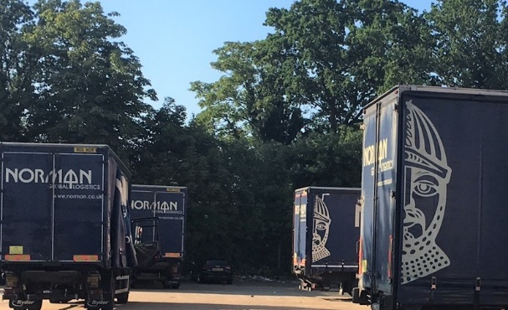
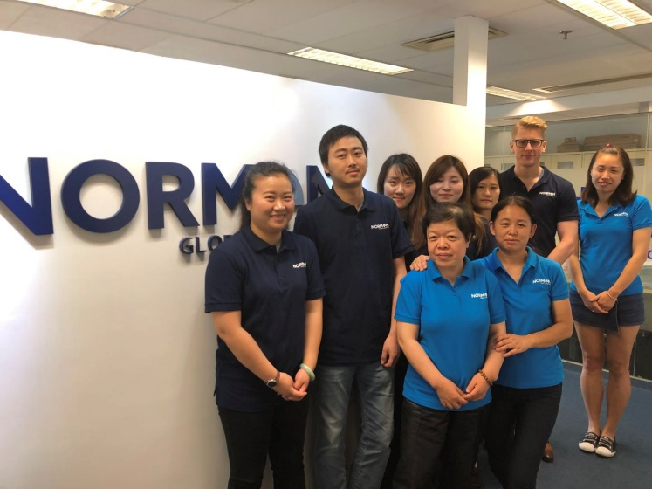
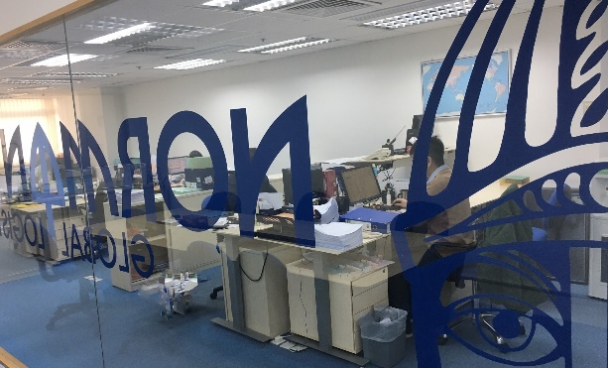
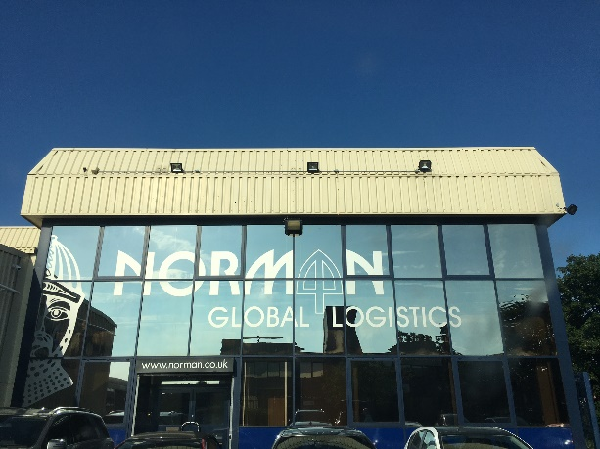
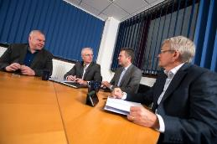
Introduction
Established in 1970
Privately Owned
135+ Employees
5 UK Branches
  Heathrow – Head Quarters
  Felixstowe
  Northampton
  Manchester
  Liverpool
6 Asia locations
China Branches
  Hong Kong
  Shanghai (A-class licence)
  Ningbo (A-class licence)
  Qingdao (A-class licence)
  Xiamen – (A-Class license)
Vietnam Office
  Ho chi Minh City

Slide 3

NGL DNA
    Strong commitment and continuity of senior management
    Long serving and professional work force
    Account managers for partners & key customers
    Mix of Local and Foreign staff
    Modern IT solution and Customer solutions system

Slide 4

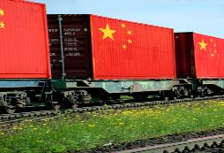
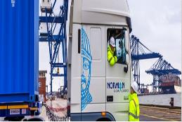
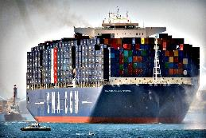
Asia Import / Export Services
  LCL / FCL / Airfreight & Rail Service
  Custom Clearance / Bonded Storage EPZ Storage
  Buyers Consolidations
  70,000sqft of bonded & non-bonded warehousing
  Pick / Pack & Labeling facilities
  Special commodity services
  Projects
  Ro/Ro cargo
  Break Bulk
  Auto Pre-alert system
  E-Commerce
  Track & Trace

Slide 5


NGL Locations in China
Hong Kong & South China HQ:
Norman Global Logistics Hong Kong Limited.
Tower 1, 8/F, Unit 811 Cheung Sha Wan Plaza,
833 Cheung Sha Wan Road
Kowloon
Hong Kong
Tel: +852 3582 3440
Fax: +852 3582 4366
Email: Hongkong@normanglobal.com
Northern China HQ:
Norman Global Logistics Limited.
Room 601 International Capital Plaza,
No 1318 North Sichuan Road
Shanghai 200080
China
Tel: +86 21 3656 2090
Fax: +86 21 3656 2081
Email: Shanghai@normanglobal.com
Qingdao
Shanghai
Ningbo
Xiamen
Shenzhen
Hong Kong

Slide 6

NGL Locations in Vietnam
Ho Chi Minh City
Room 1101/1 Floor 11 Area B – WASECO Building
No.10 Pho Quang Street, Ward 2,
Tan Binh Dist
Ho Chi Minh City
Vietnam
T: +84 8 9102288
F: +84 8 9101785
Attn: Robert Foster
E-mail: vietnam@normanglobal.com
Also offices/affiliates in:
Ho Chi Minh City
Hanoi

Slide 7
SERVICES
Buyers consolidation – Mainland China
Norman Global Logistics Hong Kong Limited
Name | Position | E-mail | Mobile
Management
Mr. Stefan Holmqvist | Managing Director | stefan.holmqvist@normanglobal.com | (852) 9167 1763
Ms. Ida Cheung | General Manager | ida.cheung@normanglobal.com | (852) 9040 6333
Norman Global Logistics (Shanghai) Co., Limited
Ms. Tina Xi | Branch Manager | tina.xi@normanglobal.com | (86) 138 1819 7371
Mr. Robert Foster | BDM | robert.foster@normanglobal.com | (86) 138 1756 4514
Mr. Edoardo Pazzaglia | Business Development | edoardo.pazzaglia@normanglobal.com | (86) 135 6419 3446
Norman Global Logistic (Shanghai) Limited Qingdao Branch
Ms. Linn Jiang | Branch Manager | linn.jiang@normanglobal.com | +86 18561611586
Mr. Robert Foster | BDM | robert.foster@normanglobal.com | +86 138 1756 4514
Norman Global Logistics Ningbo
Ms. Judy He | Branch Manager | judy.he@normanglobal.com | +86 189 5749 9900
Mr. Robert Foster | BDM | robert.foster@normanglobal.com | +86 138 1756 4514
Norman Global Logistics Xiamen
Ms. Susan Lee | Customer Service Manager | susan.lee@normanglobal.com | +86 013 599505379
Ms. Vina Luo | Operation | sandy.ye@normanglobal.com | +86 013 960709842
Ms. Dona Chen | Finance | dona.chen@normanglobal.com | +86 013860456356
Norman Global Logistics Beijing
Ms. Linn Jiang | Branch Manager | linn.jiang@normanglobal.com | +86 18561611586
Mr. Robert Foster | BDM | robert.foster@normanglobal.com | +86 138 1756 4514
Norman Global Logistics Ho Chi minh City
Mr. Robert Foster | BDM | robert.foster@normanglobal.com | +86 138 1756 4514
Operations
Ms. Tina Nguyen | Key Contact | tina.nguyen@normanglobal.com | +84 9036 37872
Ms. Jess Nguyen | Customer Service | jess.nguyen@normanglobal.com | +84 12222 64673
Key Contacts

Slide 8
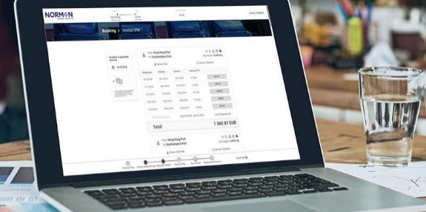
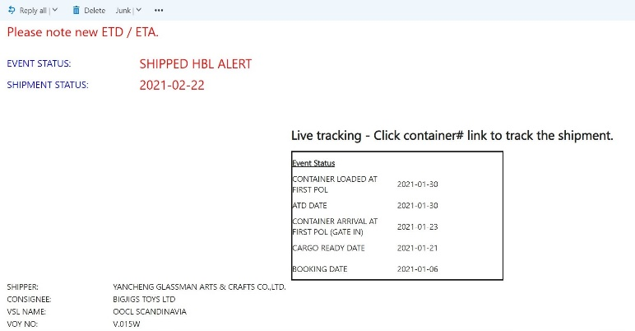
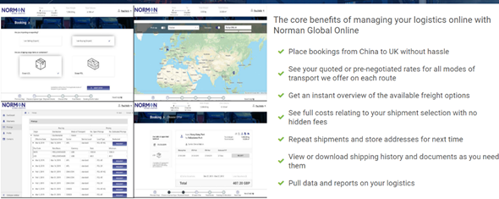
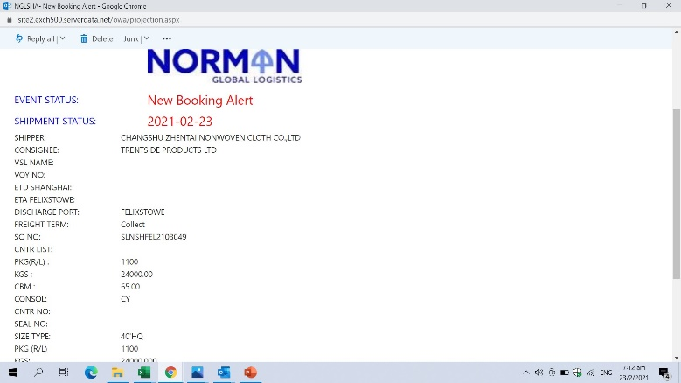
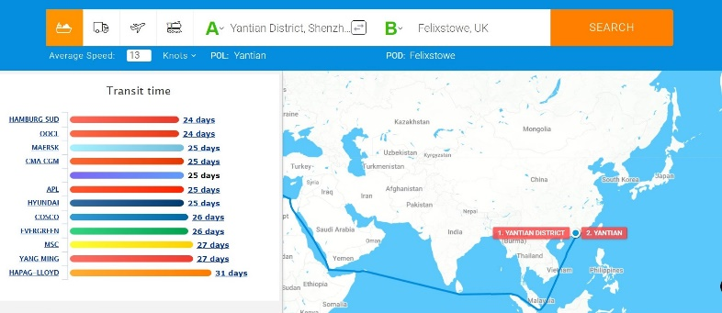
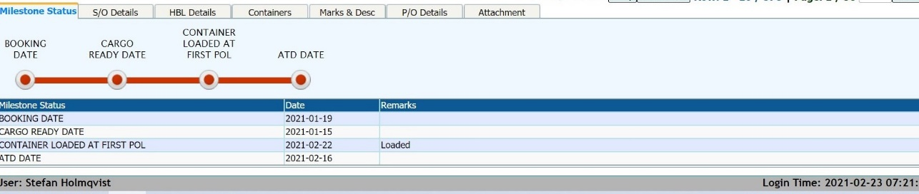
NGL Online
SERVICES
Buyers consolidation – Mainland China
Sales & Marketing
Visibility online
Manage Rates, Schedules & Bookings
Events updates
Service finder
Milestones

Slide 9
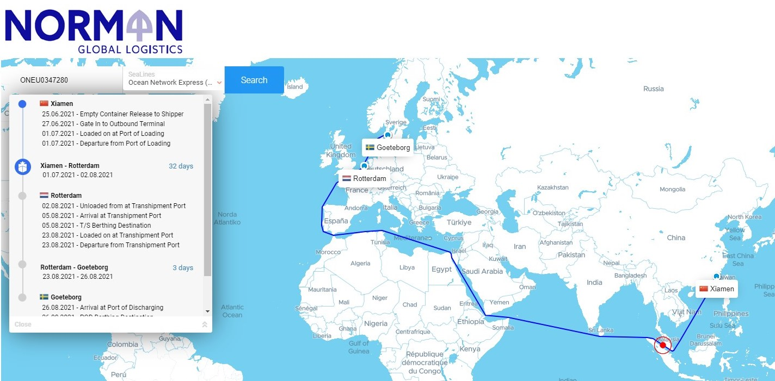
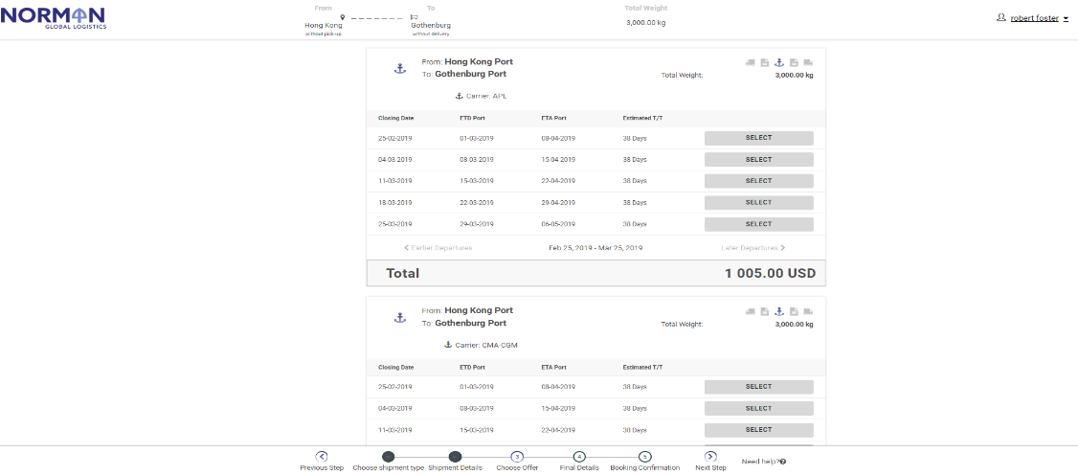
NGL Online
Milestones & Events
Online Quotes
Instant Bookings
Online schedules
Customized Dashboard
Shipment Overview

Slide 10
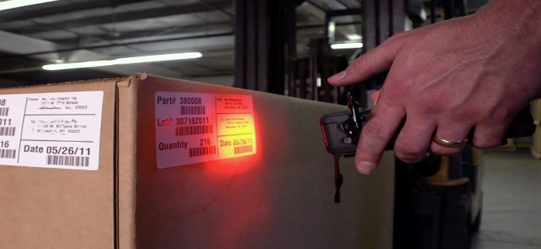
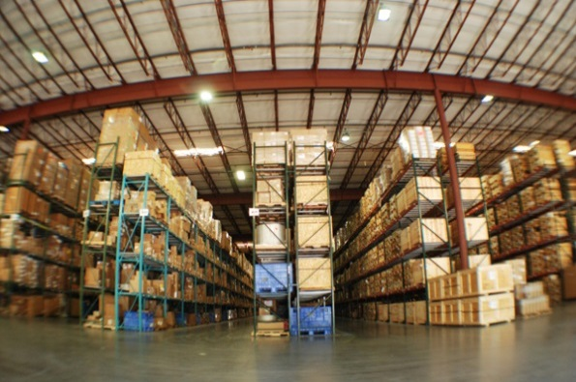
Warehousing in China
Inventory / order management
Pick & pack
Buyers consolidations
Labeling
Well maintained equipment
Bonded & non-bonded facilities
Bar Labeling & Scanning
EDI with customs
Tailor-made logistics solution
In House Warehouse Management System

Slide 11
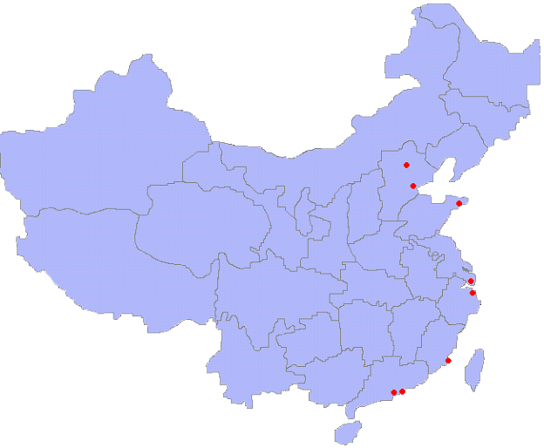
China HUB - Services
SERVICES
Buyers consolidation – Mainland China
Ideal set-up for overseas importers that work with multiple China suppliers
Major industries; garments, automotive and in general consumer goods
North China: Tianjin
Central China: Shanghai
South China: Hong Kong / Shenzhen
Inventory Reporting per tailored requirements
Weekly departures with fixed schedules
Operated as LCL at origin / FCL at destination
Dedicated warehouse staff
Supplier control (lead time / QC / Loading)
Possible net savings on the combined logistics efforts
Less handling at destination / less risk of damage
NORTH HUB
CENTRAL HUB
SOUTH
HUB

Slide 12
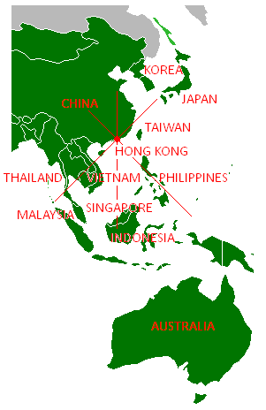
China HUB - Services
SERVICES
Hub activities
Overseas / Local suppliers
Central warehouse in Hong Kong or China BLP
Regional supply hub
Order Management & Follow Up
Palletize, Wrapping, Labeling & Order-pick
Multiple Delivery addresses
Online Management tool
Inventory Reporting
Cargo ready for export

Slide 13

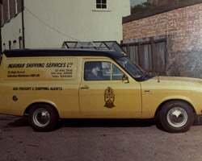
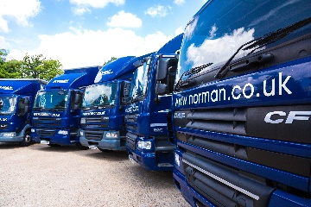
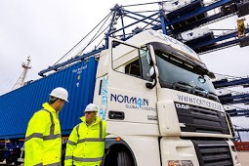
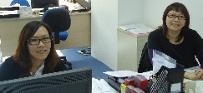
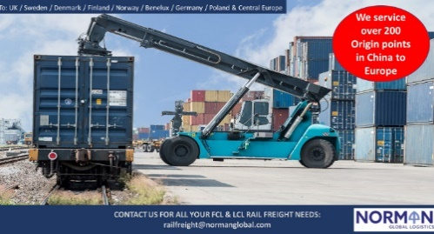
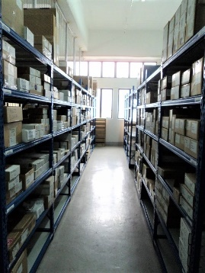
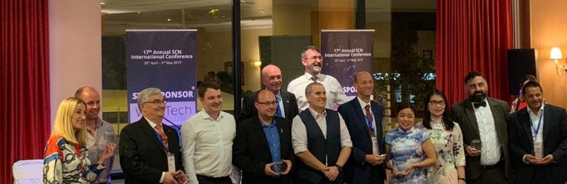

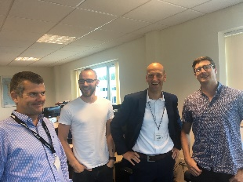
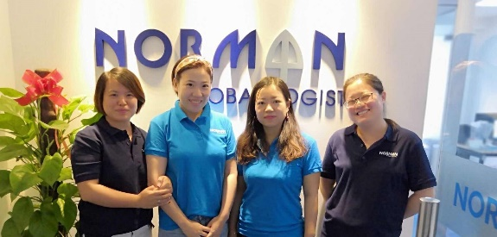

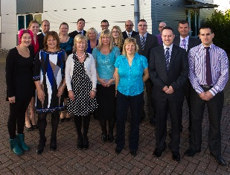
NGL DNA
Strong finance
Modern
Strong culture and a history
ON LINE Sales & Marketing
Professionals for Land, Ocean, Air, Rail & Logistics
Strong relations,
HTFN, SCN, WCA
International Team
Serving community

Slide 14
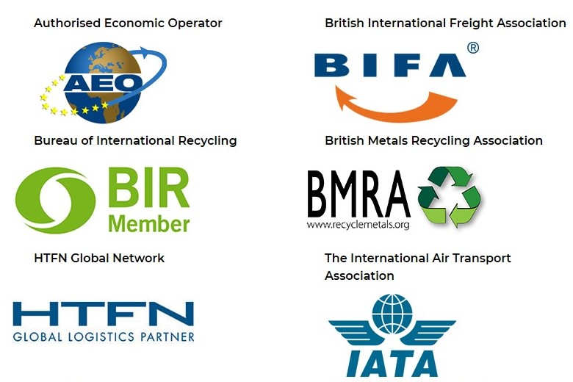
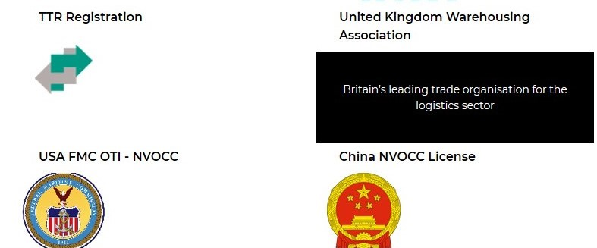
SERVICES
Buyers consolidation – Mainland China
Accreditations

