Slide 1


We Make It Happen
One Shipment at a Time®
ITAR Overview

Slide 2
WHAT FACTORS MAKE A SHIPMENT FALL WITHIN ITAR CLASSIFICATION?
Any manufactured product or ‘part’ that was utilized previously for military use, currently being manufactured for the purpose military use, or can be modified for future military application.
The ITAR is contained in 22 CFR 120 – 130
ITAR is charged with controlling the export and temporary import of defense articles and defense services covered by the United States Munitions List (USML)
With certain exceptions, all exports or temporary imports of U.S. defense articles, defense services or technical data to foreign persons require formal authorization from the Directorate of Defense Trade Controls (DDTC)
United States Munitions List (USML) is contained within 22 CFR 121.1
There are 21 categories
Learn the categories that your clients ship
Category XX! Is only available for use with a CJ (Commodity Jurisdiction)

Slide 3
ITAR REGISTRATION REQUIREMENTS
129.3 – Requirements to register
(b) Exemptions. Registration under this section is not required for:
(3) Persons exclusively in the business of financing, transporting, or freight forwarding, whose business activities do not also include brokering defense articles or defense services.
Example:
Air carriers and freight forwarders who merely transport or arrange transportation for licensed United States Munitions List items are not required to register
Nor are banks or credit companies who merely provide commercially available lines of credit or letters of credit…required to register.
(Tuttle Law 2011)

Slide 4
LAWS & REGULATIONS
Arms Export Control Act (AECA) – 22 U.S.C 2778
https://uscode.house.gov/view.xhtml?req=(title:22%20section:2778%20edition:prelim)%20OR%20(granuleid:USC-prelim-title22-section2778)&f=treesort&edition=prelim&num=0&jumpTo=true
The AECA provides the authority to control the export of defense articles and defense services. The AECA charges the President to exercise this authority, which has been delegated to the Secretary of State
International Traffic in Arms Regulations (ITAR) – 22 CFR 120-130
https://www.ecfr.gov/cgi-bin/text-idx?SID=9b3f0aa525eceee21089dcb6367e3b98&mc=true&tpl=/ecfrbrowse/Title22/22CIsubchapM.tpl
The International Traffic in Arms Regulations (ITAR), is charged with controlling the export and temporary import of defense articles and defense services covered by the United States Munitions List (USML)

Slide 5
WHAT IS AN EXPORT….AS DEFINED WITHIN THE ITAR
Export means:
Sending or taking a defense article out of the United States in any manner, except by mere travel outside of the United States by a person whose personal technical data; or
Transferring registration, control or ownership to a foreign person of any aircraft, vessel, or satellite covered by the U.S. Munitions List, whether in the United States or abroad; or
Disclosing (including oral or visual disclosure) or transferring in the United States any defense article to an embassy, any agency or subdivision of a foreign government (e.g., diplomatic missions); or
Disclosing (including oral or visual disclosure) or transferring technical data to a foreign person, whether in the United States or abroad; or
Performing a defensive service on behalf of, or for the benefit of, a foreign person, whether in the United States or abroad
A launch vehicle or payload shall not, by reason of the launching of such vehicle, be considered an export for purposes of this subchapter. However, for certain limited purposes (see 126.1 of this subchapter), the controls of this subchapter any apply to any sale, transfer or proposal to sell or transfer defense articles or services.

Slide 6
U.S. MUNITIONS LIST (USML) – 22 CFR 121.1
Category I: Firearms, close assault weapons, combat shotguns
Category II: Guns and armaments
Category III: Ammunition, ordinance
Category IV: Launch vehicles, missiles, rockets
Category V: Explosives, incendiary agents
Category VI: Naval vessels
Category VII: Military vehicles
Category VIII: Aircraft and equipment
Category IX: Military training services, equipment
Category X: Protective personnel equipment and shelters

Slide 7
U.S. MUNITIONS LIST (USML) – 22 CFR 121.1 - continued
Category XI: Military electronics
Category XII: Optical and guidance control equipment
Category XIII: Auxiliary equipment (cameras, encryption, camouflage)
Category XIV: Toxicological, chemical, biological agents, protective equipment
Category XV: Space systems and equipment
Category XVI: Nuclear weapons, technology
Category XVII: Classified technical data and services
Category XVIII: Directed energy weapons
Category IXX: Reserved
Category XX: Oceanographic equipment
Category XXI: Other items designed or adapted for military use (Misc.)

Slide 8
JURISDICTION
120.3 – Policy on designation & determining defense articles & services
An article or service may be designated or determined in the future to be a defense article (see 120.6) or defense service (see 120.9) if it:
Is specifically designed, developed, configured, adapted, or modified for a military application, and
(i) Does not have predominant civil applications, and
(ii) Does not have performance equivalent (defined by form, fit or function) to those of an article or service used for civil applications; or
(b) Is specifically designed, developed, configured, adapted, or modified for a military application, and has significant military or intelligence applicability such that control under this subchapter is necessary
The intended use of the article or service after its export (i.e. for military or civilian purpose) is not relevant in determining whether the article or service is subject to the controls of this subchapter. Any items covered by the U.S. Munitions List must be within the categories of the U.S. Munitions List.
If the above criteria is not applicable, then the article or service is regulated by the Export Administration Regulation.

Slide 9
CONSOLIDATED SCREENING LIST
The Consolidated Screening List (CSL) is a list of parties for which the United States Government maintains restrictions on certain exports, re-exports or transfers of items
https://www.trade.gov/consolidated-screening-list
The website tools provide links to the CSL search engine, downloadable CSL files, and the CSL Application Programming Interface (API), all consisting of the consolidation of multiple export screening lists of the Department of Commerce, State and Treasury.
All the tools are updated automatically every day at 5:00AM EST/EDT.
Key Sources
Department of Commerce – Bureau of Industry & Statistics
Department of State – Directorate of Defense Trade Controls
Department of the Treasury – Office of Foreign Assets Control

Slide 10
CONSOLIDATED SCREENING LIST - continued
Key Considerations
These tools are a consolidation of multiple export screening lists of the Department of Commerce, State and Treasury and may be used as an aid in conducting electronic screens of potential parties to regulated transactions
In the event that a company, entity or person on the list appears to match a party potentially involved in your export transaction, additional due diligence should be conducted before proceeding.
There may be a strict export prohibition, requirement for seeking a license application, evaluation of the end-use or user to ensure it does not result in an activity prohibited by any U.S. export regulations
Prior to taking further action, to ensure full compliance with all terms and conditions of the restrictions placed on the parties on the list, the user must check the official publication of restricted parties in the Federal Register. They should also check the official lists of restricted parties maintained on the web sites of the Department of Commerce, State and Treasury.

Slide 11
BEFORE ANY EXPORT CAN BE PROCESSED…..CHECK
Denied Persons List
https://www.bis.doc.gov/index.php/policy-guidance/lists-of-parties-of-concern/denied-persons-list
Denied Entity List
https://www.ecfr.gov/cgi-bin/text-idx?SID=a76216a0cd39ca169dbf8980537a0bee&mc=true&node=pt15.2.744&rgn=div5
Debarred List
https://www.pmddtc.state.gov/ddtc_public?id=ddtc_kb_article_page&sys_id=c22d1833dbb8d300d0a370131f9619f0
Unverified List
https://www.bis.doc.gov/index.php/documents/consolidated-entity-list/unverified-list/1053-unverified-list
Specially Designated Nationals List
https://home.treasury.gov/policy-issues/financial-sanctions/specially-designated-nationals-and-blocked-persons-list-sdn-human-readable-lists
Consolidated
https://2016.export.gov/ecr/eg_main_023148.asp

Slide 12
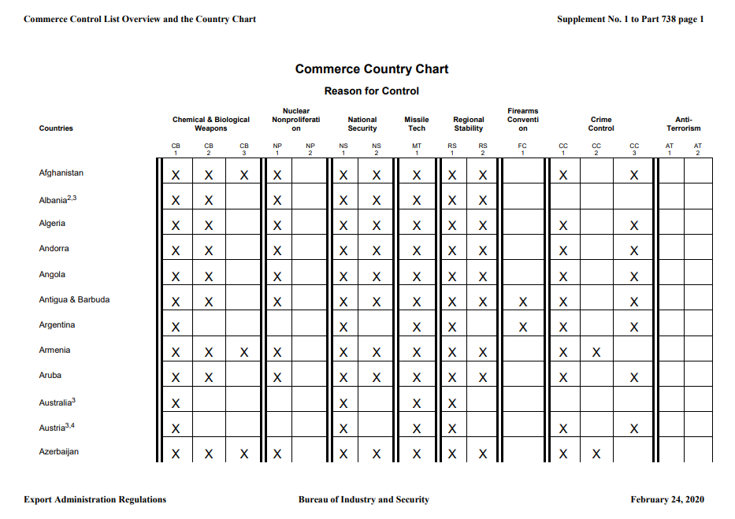
COUNTRY COMMERCE CHART
https://www.bis.doc.gov/index.php/documents/regulations-docs/2253-supplement-no-1-to-part-738-commerce-country-chart/file

Slide 13
ITAR 126.1 – PROHIBITED EXPORTS, IMPORTS, AND SALES TO OR FROM CERTAIN COUNTRIES
(a) General. It is the policy of the United States to deny licenses and other approvals for exports and imports of defense articles and defense services, destined for or originating in certain countries
(b) Shipments. A defense article licensed or otherwise authorized for export, temporary import, re-export or retransfer under this subchapter may not be shipped by any conveyance that is owned, operated by, or leased from any of the proscribed countries, areas or persons referred to in this section.
(c) Identification in 126.1of the ITAR may derive from:
Exports and sales prohibited by the U.N. Security Council sanction measures
Terrorism
Arms embargoes and sanctions
https://www.ecfr.gov/cgi-bin/retrieveECFR?gp=&SID=38419fdf18e40e3362a98a8a2a5ffacd&mc=true&n=pt22.1.126&r=PART&ty=HTML#se22.1.126_11

Slide 14
ITAR 126.1 – PROHIBITED EXPORTS, IMPORTS, AND SALES TO OR FROM CERTAIN COUNTRIES - continued
(d) Countries subject to certain prohibitions:
For defense articles and defense services, the following countries have a policy of denial:
Belarus, Burma, China, Cuba, Iran, North Korea, Syria, Venezuela
For defense articles and defense services, a policy of denial applies to the following countries except as specified in 126.1
Afghanistan, Central African Republic, Cyprus, Democratic Republic of Congo, Eritrea, Haiti, Iraq, Lebanon, Libya, Somalia, South Sudan, Zimbabwe

Slide 15
DIFFERENT TYPES OF LICENCES / FORMS
DSP-5: License for permanent export of unclassified defense articles and related technical data
DSP-61: License for the temporary import of unclassified defense articles
DSP-73: License for temporary export of unclassified defense articles
DSP-83: Non-transfer and use certificate
https://www.pmddtc.state.gov/ddtc_public?id=ddtc_kb_article_page&sys_id=d0ea875edbb4130044f9ff621f9619f7
Form 6 – Part I: Permit for the permanent import of unclassified defense articles and related technical data 27 CFR 447.41; 27 CFR 447.21 – The U.S. Munitions Import List (BATFE)
https://www.atf.gov/firearms/docs/form/form-6-part-1-application-and-permit-importation-firearms-ammunition-and

Slide 16
REQUIREMENT FOR EXPORT OR TEMPORARY IMPORT LICENSES
Shipper’s Responsibilities – Subchapter 123.1
Any person who intends to export or to import temporarily a defense article must obtain approval of the Directorate of Defense Trade Controls prior to the export or temporary import, unless the export or temporary import qualifies for an exemption under the provisions of this subchapter.
https://www.ecfr.gov/cgi-bin/text-idx?SID=7ed8c29accdebf389faf51f4ce1ea0fd&mc=true&node=pt22.1.123&rgn=div5#se22.1.123_11

Slide 17
REQUIREMENT FOR EXPORT OR TEMPORARY IMPORT LICENSES
Aeronet’s Responsibilities – Subchapter 123.22
Filing, retention, and return of export licenses and filing of export information
Any export, as defined in the subchapter, of a defense article controlled by this subchapter, to include defense articles transitioning the U.S., requires the electronic reporting of export information.
The reporting of the export information shall be to the U.S. Customs and Border Protection (CBP) using its electronic system(s), or directly to the Directorate of Defense Trade Controls (DTTC), as appropriate.
https://www.ecfr.gov/cgi-bin/text-idx?SID=7ed8c29accdebf389faf51f4ce1ea0fd&mc=true&node=pt22.1.123&rgn=div5#se22.1.123_122

Slide 18
AUTOMATED EXPORT SYSTEM (AES) FILING REQUIREMENTS
Exemption Statements
If a shipment is filed electronically through AES, shipping documents including the commercial invoice, air waybill or ocean bill of lading must contain a properly worded exemption statement that includes the filer generated External Transaction Number (XTN) or the Customs AES system generated Internal Transactions Number (ITN) number.
Examples
AES XTN (where XTN is the filer’s Export Identification Number (EIN) plus the shipment reference number) – “AES 103222766 – BX95909763”
AES ITN (where ITN is the number transmitted by AES back to the filer acknowledging acceptance of the submission) – “AES X20020714231567”

Slide 19
DESTINATION CONTROL STATEMENTS
General Statement for Exports
These items are controlled by the U.S. Government and authorized for export only to the country of ultimate destination for use by the ultimate consignee or end-user(s) herein identified. They may not be resold, transferred, or otherwise disposed of, to any other country or to any person other than the authorized ultimate consignee or end-user(s), either in their original form or after being incorporated into other items, without first obtaining approval from the U.S. government or as otherwise authorized by U.S. laws and regulations.

Slide 20
DESTINATION CONTROL STATEMENTS
Statement for Export Exemption Shipments
These commodities are authorized by the U.S. Government for export only to Kuwait for use by SNC under license exemption 22 CFR 126.4(c). They may not be resold, diverted, transferred, or otherwise disposed of, to any other country or to any person other than the authorized end-user or consignee(s), either in their original form or after being incorporated into other end-items, without first obtaining approval from the U.S. Department of State or use of applicable exemption.
Special Instructions
Country of Origin: United States
License Exemption: 22 CFR 126.4(c)
Symbol/Authorization:
This shipment is in support of Contract FAxxxxxx
Delivery Order: xxxx
Support Effort. 22 CFR 126.4(c) applicable

Slide 21
ADDITIONAL STEPS IN EXPORT OPERATIONS PROCESS
Aeronet’s Responsibilities - Documentation verification and review
Verify shipper, consignee or interested parties against the Consolidated Security List & Denied Parties List
Ensure the goods have the proper licenses for commodity & terms of shipments
Verify that the ultimate country of destination is not a sanctioned country
Ensure the export documents have the Destination Control Statement (DCS)
Review the commercial invoice against license or exemption to ensure they match
Review License for authorized agents and ensure Aeronet or Aeronet partner is named on the license

Slide 22
WHY SHOULD YOU CARE ABOUT SELLING ITAR?
Not many competitors educated upon ITAR requirements and able to guide clients through the process
Due to heavy fines, many forwarders do not pursue ITAR
EXTREMELY HIGH MARGINS
Aeronet is ITAR registered (not required), but shows our commitment to ITAR compliance capabilities
Once embedded with a client, very low chance for client volatility, and often leads to additional business
Allows a new/unique service offering to re-engage cold or lost clients
We have a highly trained/experienced team in DEN

Slide 23
TYPES OF COMPANIES/INDUSTRIES THAT WOULD HAVE ITAR SHPTS
U.S. military contracted brokers
E.g. Sierra Nevada Corp.: 3rd party broker contracted directly via U.S. military to source/procure directly from manufacturers and/or suppliers
Our last ITAR shipment was an ejection seat for an F-18 jet, both ITAR & DG
Commercial / Military – “cross-over” clients
These clients have commercially sold products but have military applications or have enhanced products specifically engineered for military grade usage
Nite Eyes – Night vision goggles
Laser Tech – Commercial: Radar guns vs. Military: Distance measuring optical scopes
Skydex – Commercial: Football helmet pads vs. Military: Helmet pad replacements & knee pads

Slide 24





THANK YOU
Connect with Us

