Slide 1
Introduction Fiscal Representation
Custom clearance after Brexit

Slide 2

Gateway to Europe
      Gateway to Europe
      (500 million consumers)
The port of choice for the European market.
Connections to over 1,000 ports worldwide.
Easy access for even the largest vessels.
First and last port of call in Europe.
Strategic location.
      Custom clearance in the Netherlands means VAT obligations
Iceland
Norway
Finland
Sweden
Estonia
Russia
Latvia
Denmark
Lithuania
Ireland
The
Netherlands
United
Kingdom
Poland
Germany
Belgium
France
Switserland
Austria
Portugal
Spain
Italy
Greece
Turkey
Morocco
Algeria
Tunisia

Slide 3
Dutch customs
      Attractive cash
      flow advantage
Custom clearances mean you have to pay import duties & VAT.
Apply for refund of VAT takes
two to three months.
The Netherlands have
a unique VAT deferral policy which can mean you do not have to pay upon arrival
Fast & simple considerable savings.

Slide 4
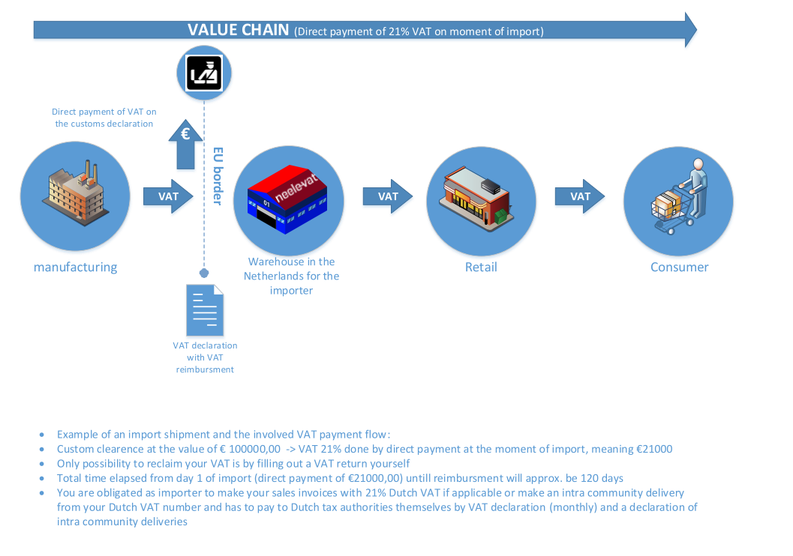

Slide 5
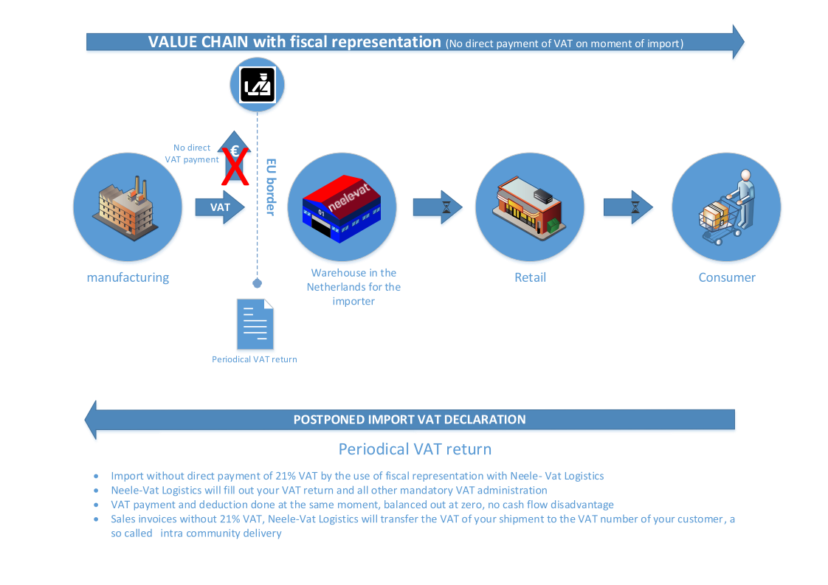

Slide 6

Which value for the custom clearance
When goods are purchased from another company we can use the purchase invoice between the seller and your company but only if you have not yet sold your goods.
If you have already sold your goods we will custom clear on the sales invoice between your company and the buyer.
If you custom clear goods after a bonded warehouse in the Netherlands we will use the sales invoice between your company and the buyer.
If you transfer goods produced by your own company and the goods have been sold before we custom clear we will clear on the sales invoice between your company and the buyer.
If you transfer goods produced by your own company and the goods have not been sold the value must be calculated via special methods. Please request more information regarding this topic.

Slide 7
Two kinds of representation
Limited fiscal representation (LFR)
You will need to sign a limited fiscal contract and will use the VAT number of Neele Vat and are able to profit of the article 23 of Neele- Vat
You will need to sign a contract direct representation so we can act as your customs broker for the clearances
Quick start up
Only import and the following deliveries
Not able to mix up free goods and custom cleared goods
Sales invoices stating Neele Vat as your limited fiscal representative and the VAT number of Neele Vat
No mention of Dutch VAT. Sale will be delivered directly from the Netherlands and the VAT transferal will go to the VAT number of your customer
Intrastat will be done under the VAT number of Neele-Vat, this is a combined declaration so no insight
No Exworks or FCA
General fiscal representation (GFR)
You will need to sign a general fiscal contract and a request for a VAT number. You will receive your own VAT number and article 23.
You will need to sign a contract direct representation so we can act as you customs broker for the clearances
Start up around 6 to 8 weeks ( meanwhile limited is possible)
Import and following deliveries but also purchases in the EU.
Mix up goods customs cleared Neele-Vat and free goods
Sales invoices stating Neele Vat as your General fiscal representative and the Dutch VAT number of your company
No mention of Dutch VAT. Sale will be delivered directly from the Netherlands and the VAT transferal will go to the VAT number of your customer
Intrastat will be done under your Dutch VAT number, this is a dedicated declaration so complete insight
Exworks and FCA is possible but not recommended due to VAT obligations/ risks

Slide 8
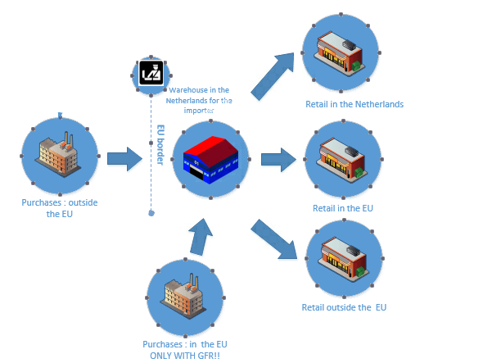
E-commerce
Amazon/ Groupon platform
Customers without a valid VAT number
Purchases in the EU
All reasons to go to GFR

Slide 9
Responsibility
Neele-Vat
Monthly VAT Submission
Monthly Intra community declaration
Monthly Intrastat listing
Delivery of goods
Proof of delivery
Importer
Sales invoice per delivery stating all invoice requirements
With an investigation from the Dutch Tax Authorities the documents concerning the delivery. For instance Proof of payment, order of customer.
In case of General fiscal representation all documents regarding the use of the NL VAT number

Slide 10
ABC transaction with UK, goods free circulation
A- NL due to fiscal representation ( country of importer is not in the ABC transaction if fiscal representation is used)
B- UK
C- EU
Before the Brexit we could use the VAT number of the company in the UK to transfer the VAT to.
After the Brexit the company in the UK will have to register in the country of his buyer and will receive a VAT number which must be mentioned on the sales invoice (A). Otherwise Dutch VAT is applicable

Slide 11
Invoice requirements
Sales invoice between importer and customer
No Dutch or local Vat
Reason why VAT is not charged has to be mentioned, this differs for:
Sale EU
Sale NL
Sale non EU
Sale EU delivery in NL
Neele- Vat acting as your Limited or General fiscal representation with our or your Dutch VAT number
Valid VAT number of your customer in Country of delivery

Slide 12
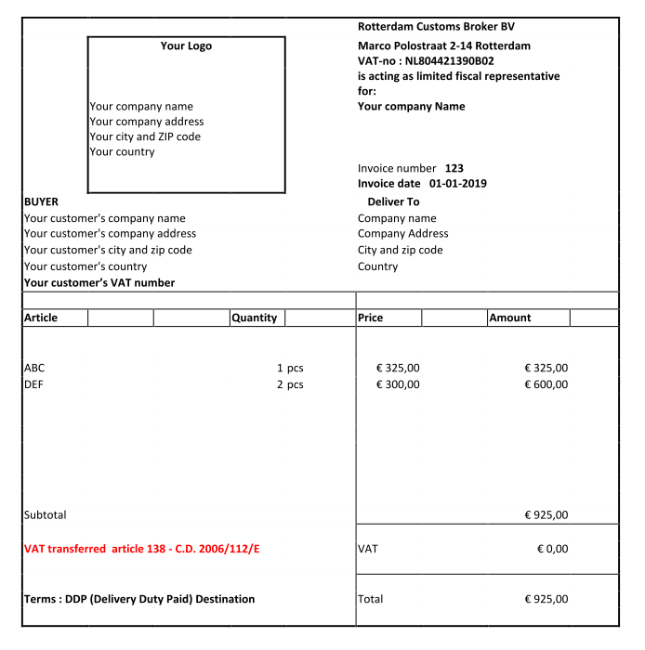
Sales Invoices to a company within the EU

Slide 13
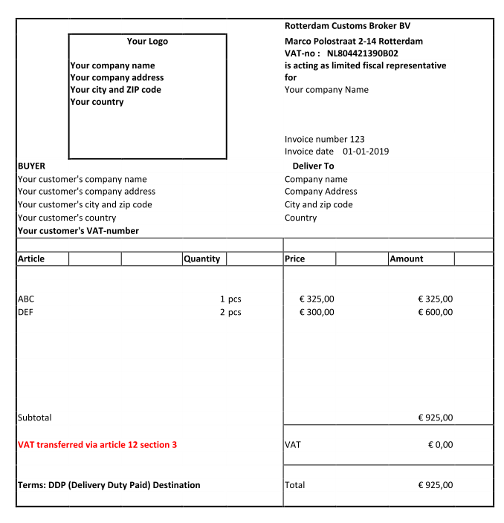
Sales Invoices to a company in NL

Slide 14
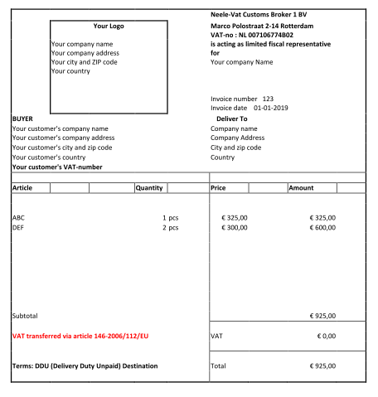
Sales Invoices to a company outside the EU ( goods custom cleared)

Slide 15
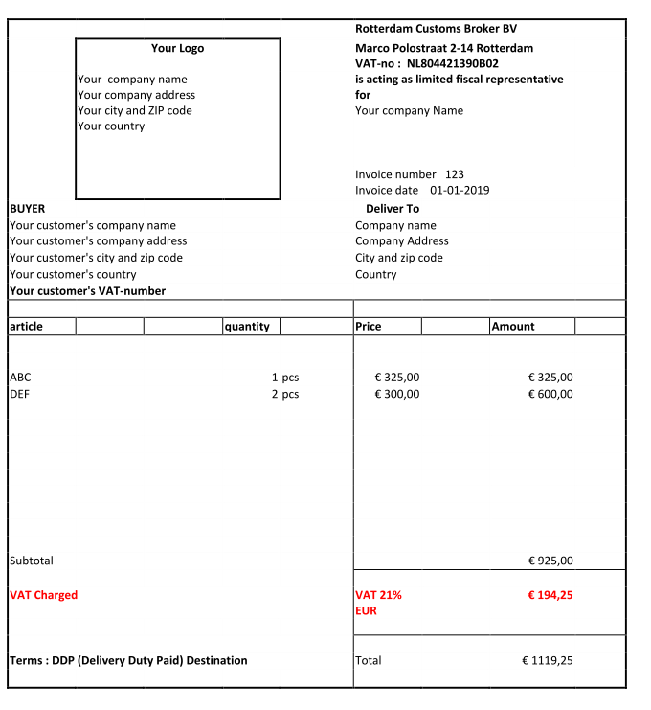
Sales Invoices samples or goods delivered in the Netherlands but to a buyer establised in another country

