Slide 1

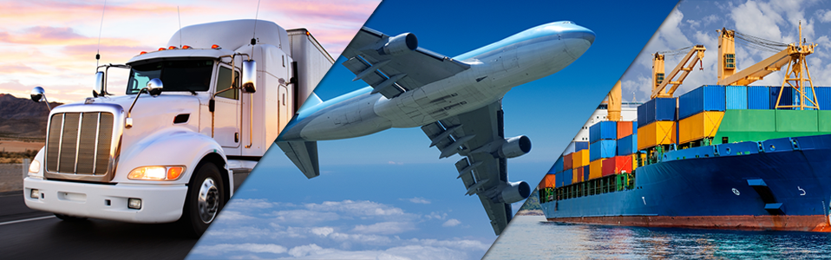
We Make It Happen
One Shipment at a Time®
Incoterms®
2020 Rules For Freight Forwarders

Slide 2
INCOTERMS IMPLICATIONS FOR FREIGHT FORWARDERS:
SALES, QUOTES & BIDS
From the forwarder’s perspective, Incoterms determine who controls the freight (i.e. who nominates the forwarder between the buyer and seller)
Critical to qualifying clients
Determines sales involvement of both origin & destination offices in the forwarder network
Reference to Incoterms must be included in any sales lead
It is impossible to provide an accurate quote to a client without knowing the Incoterms Rule
Incomplete or inaccurate quotes/bids lead to poor operations and annoyed clients
Use your knowledge of Incoterms as competitive advantage during the sales process
The ability to display a knowledge of Incoterms Rules to a customer creates a positive image

Slide 3
INCOTERMS DEFINED
International Commerce Terms, first published by the International Chamber of Commerce in 1936, defines the conditions of supply or risk transfer.
Updated every 10 years, with exporters, importers, banks, and logistics companies all making suggestions to the drafting board. http://www.iccbooks.com
Classification of Incoterms divided by mode of transport, payment for transport, and transfer of risk.
11 terms pertaining to mode of transport:
Any mode of transport: EXW, FCA, CIP, CPT DAP, DPU, DDP
For sea and inland water ways: FAS , FOB CFR, CIF
Payment for transport:
Buyer: EXW, FCA, FAS, FOB
Seller: CPT, CFR, CIP, DAP, DPU, DDP, CIF

Slide 4
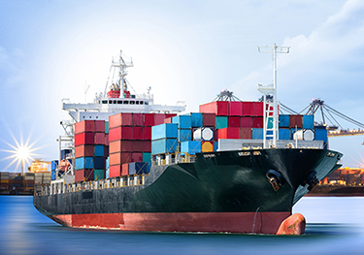
MEANING OF THE TERM “DELIVERY”
Sellers, buyers and forwarders should never assume they understand the Incoterms definition of the term “delivery”
Within the context of Incoterms, delivery does not necessarily mean up to the final destination point
That is because “delivery” under Incoterms means the point where risk of loss or damage shifts from the seller to the buyer
Delivery = Risk Transfer

Slide 5
INCOTERMS IMPLICATIONS FOR FREIGHT FORWARDERS:
OPERATIONS
Inclusion of Incoterms 2020 Rules in Shipping Instructions or Standard Operating Procedures is vital (hand-off from sales to operations)
Without referencing the Incoterms Rule it is very difficult for operations people to properly prepare transport documents
Use Incoterms® to capture all expenses and profit associated with a shipment – Accrue for all expenses – Bill for all revenues – Determine gross profit per file
Without question, Incoterms determine “who gets billed what” between a seller and a buyer

Slide 6
Analysis of the
11 Incoterms® 2020 Rules

Slide 7
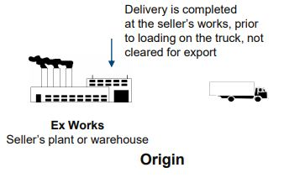
EXW: EX WORKS (NAMED PLACE OF DELIVERY)
Minimum risk to the seller
Delivery occurs when goods are made available at the seller’s facility in origin & all transport/customs related costs are for the buyer
Seller is not responsible for export customs clearance or loading of collecting vehicle
Can be used with any mode or transport or combination thereof

Slide 8
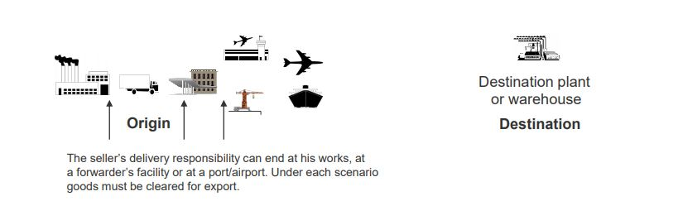
FCA: FREE CARRIER (NAMED PLACE OF DELIVERY)
There can be more than one delivery point at origin (seller’s facility, forwarder’s facility, port or airport)
Delivery occurs when goods are presented to the carrier nominated by the buyer at the named place or port, loaded on the collecting vehicle, cleared for export
“On Board” notation allowed for ocean bill of lading (if agreed upon) -Seller can use own means of carriage for delivery to port

Slide 9
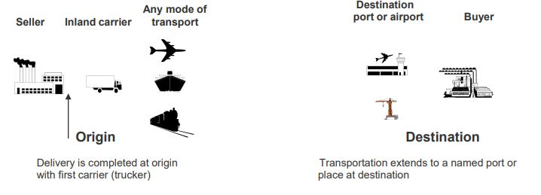
CPT: CARRIAGE PAID TO (NAMED PLACE OF DESTINATION)
Risk shifts with the first carrier at origin (normally the collecting vehicle at the seller’s facility), but seller pays transport costs to the named place at destination
Can be used for any mode of transportation or combination thereof

Slide 10
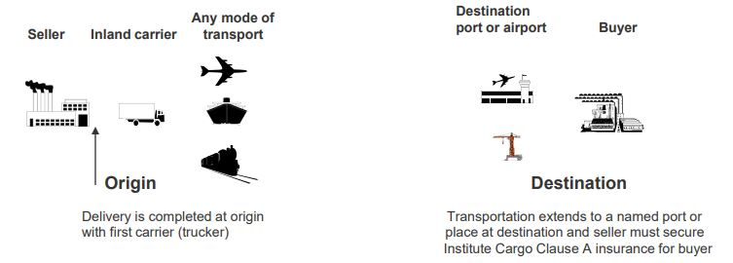
CIP: CARRIAGE & INSURANCE PAID TO (NAMED PLACE OF
DESTINATION)
Risk shifts with the first carrier at origin (normally the collecting vehicle at the seller’s facility), but seller pays transport costs to named place at destination
Seller must procure Institute Cargo Clause A insurance (Not C)
Can be used for any mode of transportation or combination thereof

Slide 11
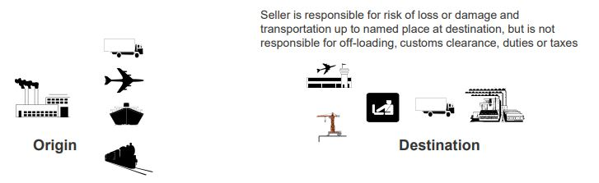
DAP: DELIVERED AT PLACE (NAMED PLACE OF DESTINATION)
Seller delivers when goods are made available to the buyer at the named place in destination, not unloaded from the delivering vehicle, and seller must pay all transport costs to that delivery point (does not include clearance, duties or taxes)
Can be used for any mode of transport
Seller/Buyer can use their own transportation at origin/destination

Slide 12


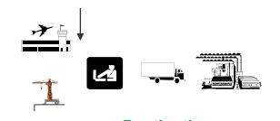
DPU: DELIVRED AT PLACE UNLOADED (NAMED PLACE OF
DESTINATION
This Incoterm replaces the rule Delivered At Terminal (DAT)
Delivery is complete when the goods are placed at the disposal of the buyer at a named place of destination, off-loaded, & seller pays transport costs to that place (does not include clearance or duties)
The only Incoterms Rule that puts onus for off-loading on the seller
Seller is responsible for risk of loss or damage and transportation up to a named place at destination, off-loaded
Origin
Destination

Slide 13
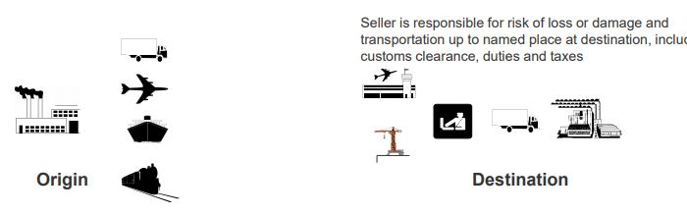
DDP: DELIVERED DUTY PAID (NAMED PLACE OF DESTINATION)
Seller delivers when goods are made available to the buyer at the named placed at destination, cleared for import but not unloaded from the delivering vehicle
Seller is responsible for all transportation, customs & related costs up to named place at destination
Seller/Buyer can use own mode of transportation at origin/destination
Can be used with any mode of transport

Slide 14
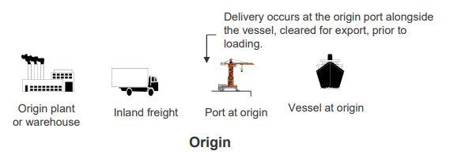
FAS: FREE ALONGSIDE SHIP (NAMED PORT OF SHIPMENT)
Delivery occurs in the port of shipment alongside the vessel, prior to loading and all charges beyond that delivery point (including loading onboard the vessel at origin) are for the buyer
Export clearance and inland freight charges up to the delivery point are for the seller’s account
Intended for ocean or inland waterway transportation only

Slide 15
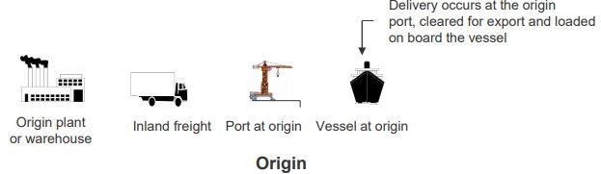
FOB: FREE ON BOARD (NAMED PORT OF SHIPMENT)
Delivery occurs in the port of shipment when goods are loaded on board the buyer’s nominated carrier (vessel) and all costs/risks beyond that point are for the buyer
Export clearance and inland freight charges up to the delivery point are for the seller’s account
Not suitable for containerized cargo (use FCA in this case)
Intended for ocean or inland waterway transportation only

Slide 16
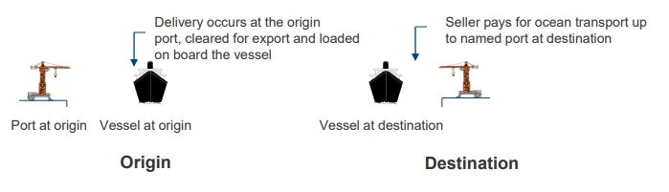
CFR: COST & FREIGHT (NAMED PORT OF DESTINATION)
Delivery occurs in the port of shipment when goods are loaded on board the vessel, but seller pays transport costs to port of arrival
Per above, risk shifts to the buyer at the port of shipment
Not meant for containerized cargo (consider CPT as an alternative)
Intended for ocean or inland waterway transport only

Slide 17
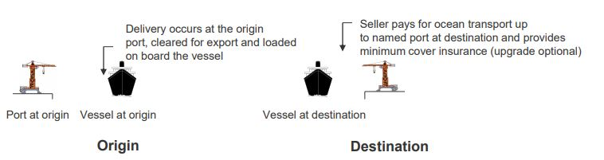
CIF: COST, INSURANCE & FREIGHT (NAMED PORT OF
DESTINATION)
Delivery occurs in the port of shipment when goods are loaded on the vessel
Risk shifts to the buyer when goods are loaded on board a ship at origin, but seller must pay all transport costs to port of arrival
Minimum cover insurance required (Inst. Cargo Clause C), but can be upgraded
Not intended for containerized cargo (consider CIP as an alternative)

Slide 18
Look in the Public Folders for your personalized version of the below

Slide 19



THANK YOU

